Slide 1
South Salem Elementary Title I stakeholders’ input & Revision MEETING
March 14, 2024
6:00 p.m.

Slide 2
Purpose of our meeting
Give all stakeholders the opportunity to provide input on
Title I Schoolwide plan
Parent and Family Engagement Policy (School and District)
School-Parent Compact
Building Staff Capacity
Reservations of Funds
Comprehensive LEA Improvement Plan (CLIP)

Slide 3
Title I school-wide plan-what is it?
The Title I SWP describes how the school will achieve the goals it has identified as a result of a comprehensive needs assessment. This is also created in conjunction with parent input.

Slide 4
2023-2024 Title I Schoolwide Plan 
2023-2024 School Goals:
Reading Goal: During the 2023-2024 school year, there will be at least 3% growth on the post-test assessment (Fastbridge and GMAS) in reading.
Math Goal: During the 2023-2024 school year, there will be at least 3% growth on the post-test assessment (Fastbridge and GMAS) in math.

Slide 5
2023-2024 Title I Schoolwide Plan 
Math Strategies Implementation of software programs designed to support reading instruction such as BrainPOP and Nearpod Small/Flexible instructional support Integrate the use of math manipulatives into learning activities Spartan Academy Tutoring Program Early Intervention Program | Reading/ELA Strategies Implementation of software programs designed to support reading instruction such as BrainPOP, Zearn, I-Ready and Nearpod Small/Flexible instructional support Integrate the use of reading manipulatives into learning activities Spartan Academy Tutoring Program Early Intervention Program | Social Studies Strategies Mandated professional learning with district personnel regarding science standards. Project-based learning opportunities Direct vocabulary instruction using curriculum map critical vocabulary. Implementation of software programs designed to support Science instruction (BrainPOP, Nearpod and Flocabulary)
Science Strategies Mandated professional learning with district personnel regarding science standards. Project-based learning opportunities Direct vocabulary instruction using curriculum map critical vocabulary. Implementation of software programs designed to support Science instruction (BrainPOP, Nearpod and Flocabulary) | Parent/Family Engagement Strategies Linked to Learning Meetings Annual Title I Parent Orientation Parent Conferences Annual Parent Input Meeting | Professional Learning Strategies Effective PLC Implementation The Instructional Coaches will ensure high-quality instruction in classrooms through modeling, co-planning, co-teaching, and providing feedback to teachers Consult with professional consultants as a means to support the teaching and learning process District level professional learning opportunities.

Slide 6
Your input on our title I SWP

Slide 7
School & district parent and family engagement policy-what is it?
Our school receives funding from Title I, part a to strengthen academic achievement.
Our school is required to develop and distribute with parents a parent and family engagement policy that establishes expectations for parent and family engagement.
Our school is also required to describe how the school will implement a number of parent and family engagement activities.
Please review the activity calendar and provide input.

Slide 8
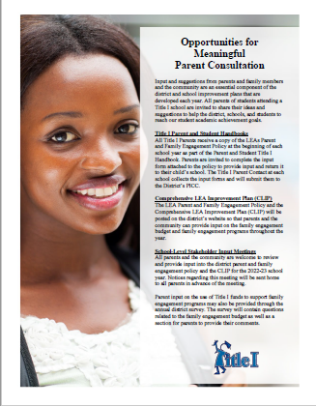
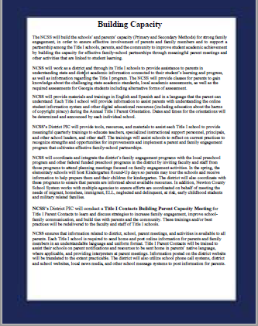
District parent and family engagement policy

Slide 9
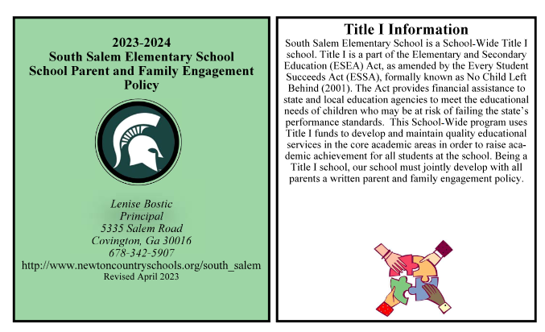
SCHOOL PARENT AND FAMILY ENGAGEMENT POLICY
Vanshelle Turner
Principal
5335 Salem Road
Covington, Ga 30016
678-342-5907

Slide 10
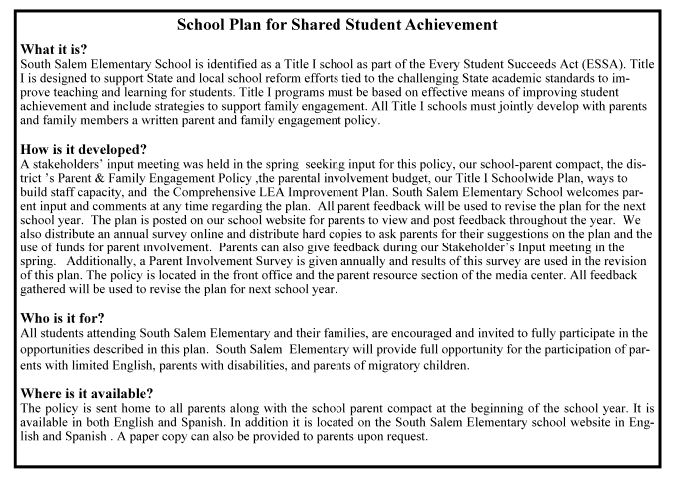
SCHOOL PARENT AND FAMILY ENGAGEMENT POLICY

Slide 11
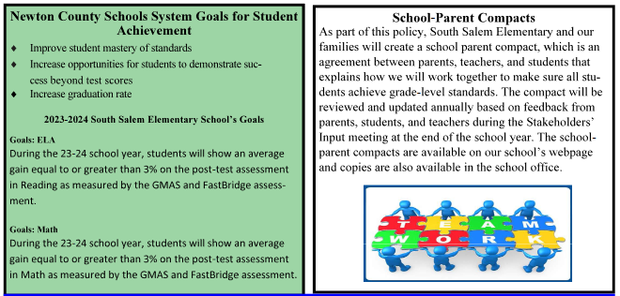
SCHOOL PARENT AND FAMILY ENGAGEMENT POLICY

Slide 12
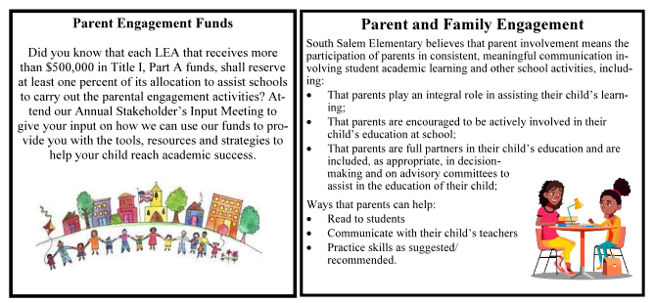
SCHOOL PARENT AND FAMILY ENGAGEMENT POLICY

Slide 13
SCHOOL PARENT AND FAMILY ENGAGEMENT POLICY

Slide 14
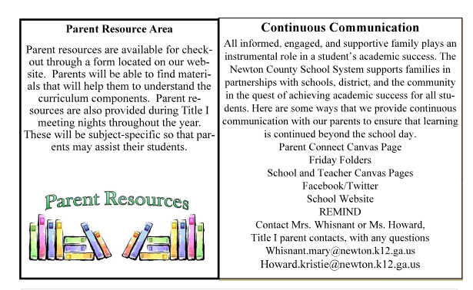
SCHOOL PARENT AND FAMILY ENGAGEMENT POLICY

Slide 15
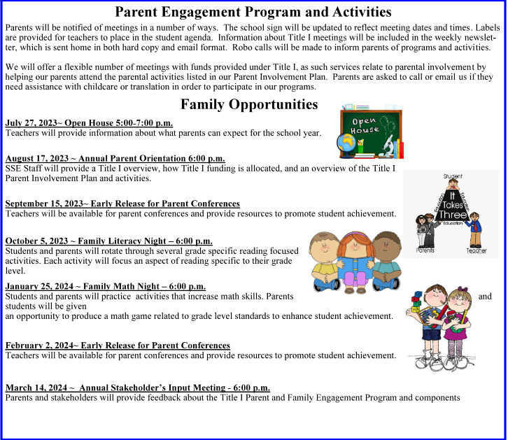
SCHOOL PARENT AND FAMILY ENGAGEMENT POLICY
Orientation: August 18
Parent Conferences: September 16 and February 3
Family Literacy Night: November 16
Family Math Night: January 25
Stakeholder’s Input Meeting: March 14

Slide 16
Your input on district and school engagement policies

Slide 17
School-parent compact-what is it?
A school-parent compact is an agreement that parents, students, and teachers develop together. It explains how parents and teachers work together to ensure all students receive the support they need to reach and exceed grade level academic standards.

Slide 18
School-parent compact 2023-2024

Slide 19
School-parent compact Responsibilities and Focus Areas 2023-2024

Slide 20
School-parent compact Responsibilities and Focus Areas 2023-2024

Slide 21
School-parent compact Responsibilities and Focus Areas 2023-2024

Slide 22
School-parent compact Responsibilities and Focus Areas 2023-2024

Slide 23
School-parent compact Responsibilities and Focus Areas 2023-2024

Slide 24
School-parent compact Responsibilities and Focus Areas 2023-2024

Slide 25
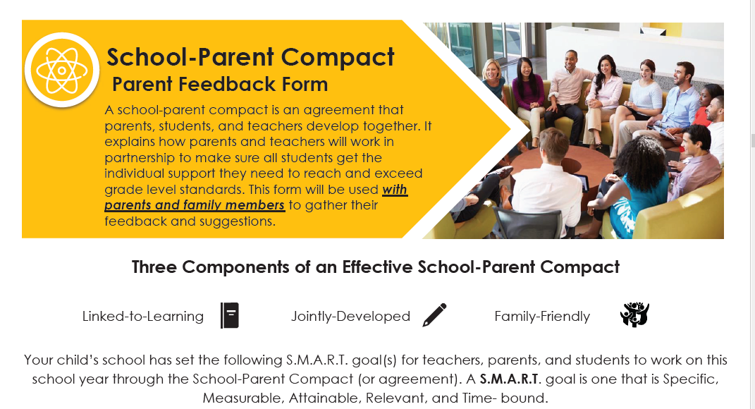
Your input on our school-parent compact

Slide 26
Building Staff Capacity-What is it?
What would you like teachers to know when working with parents in the efforts to raise student achievement?

Slide 27
Your input on building staff capacity

Slide 28
Reservations of funds - what is it?
One percent (1 %) of federal funds must be spent on parent involvement at the school.
Here is how we used our Parent Involvement Funds.
Parent Night interpreter
Resources for Parent Resource Room
Resources for Parent Communication

Slide 29
Your input on how we should use the 1% parent involvement funds

Slide 30
Comprehensive improvement plan (clip)-what is it?
The CLIP is a document developed by the schools and district and then approved by the Georgia Department of Education. It serves as a blueprint for guiding the school’s continuous improvement and progress towards identified school and district achievement objectives and targets.

Slide 31
2.1 Coherent Instructional System
How do you feel about the quality of instruction and support provided to students in NCSS? What are the strengths and opportunities for growth with our instructional practices?
2.2 Effective Leadership
What are the strengths and opportunities for growth in the leadership you have seen in your schools?
2.3 Professional Capacity
What should the district do to attract new educators (NCSS students) to the teaching profession? What type of support should the district provide to existing classroom teachers to enhance teaching methods, provide engaging lessons, and encourage student centered learning?
2.4 Family and Community Engagement
Do you feel the district creates a welcoming school environment and communicates effectively with parents/guardians? What are the strengths and opportunities for growth with parent and community engagement?
2.5 Supportive Learning Environment
In what ways do the school and district leaders work to provide safe and supportive learning environments through building maintenance, student emotional and behavioral support services, safety planning and extending learning opportunities? How could we improve?

Slide 32
Your input on the clip

Slide 33
2023-2024 Parent survey
Your input is invaluable! Please complete the parent survey by using a link placed on our website (coming soon).
Paper copies of this survey will also be available in the front office during the weeks of April 15-26 if needed.

Slide 34
Thank you!
Questions?
Comments?
Concerns?

Slide 35
Contact information
Principal: Dr. Vanshelle Turner
turner.vanshelle@newton.k12.ga.us
Title I Parent Contact: Mary Catherine Whisnant
whisnant.mary@newton.k12.ga.us

